Slide 1
P R O J E C T R E P O R T
STUDENT
Bui Huu Loi
4-BIT RISC CPU
ID
SE196720
UNIVERSITY
FPT University
Design & Implementation in Verilog HDL
MAJOR
IC Design
with 3-Stage Pipeline Architecture
TOOLS
Vivado 2026.1, Verilog
DEVICE
4-bit datapath
12-bit instruction
4 registers
IF / ID / EX
Artix-7 xc7a35tcpg236-1
TIME
10/2026

Slide 2
AGENDA
01
Introduction & Specs
02
Architecture & Pipeline
Objectives, technical specifications
Load/store, Harvard, IF/ID/EX, hazards
03
Instruction Set (ISA)
04
Datapath & Control Unit
12-bit format, 12 instructions
ALU, flags, decoder, branch unit
05
Testing & Simulation
06
Synthesis & Conclusion
Testbench, results, waveform
Timing, performance, future work
Bui Huu Loi · SE196720 · 4-Bit RISC CPU
02

Slide 3
INTRODUCTION & OBJECTIVES
Datapath
Control Path
Registers, ALU, memory, MUX, buses
→ Data storage and processing
Instruction decoding
→ Generates select/enable/write signals to control the datapath
Project Objectives
► 4-bit ALU: ADD, SUB, AND, OR, XOR, NOT + Zero, Carry flags
► Register file (4 registers), Program Counter, Instruction/Data memory, MUXes
► Hardwired control unit (instruction decoder + branch unit)
► 3-stage pipeline (IF / ID / EX) with flush mechanism for jumps
► Integration, running test programs, simulation, and synthesis on Vivado
Bui Huu Loi · SE196720 · 4-Bit RISC CPU
03

Slide 4
TECHNICAL SPECIFICATIONS
Parameter | Specification
Architecture | RISC, load/store, Harvard memory organization
Datapath Width | 4-bit (registers, ALU operands, data memory)
Register File | R0–R3, 4-bit each; 2 read ports, 1 write port
Instruction Word | 12-bit: opcode (4) | Rd (2) | Rs (2) | imm/addr (4)
Instruction Memory | 16 words × 12-bit (ROM, initialized via .mem)
Data Memory | 16 words × 4-bit (RAM)
Program Counter | 4-bit (16 addresses), wraps from 15 to 0
Instruction Set | 12 instructions; opcodes 1100–1111 reserved (act as NOP)
Pipeline | 3 stages: IF (fetch), ID (decode), EX (execute/mem/write-back)
Flags | Zero (result = 0000); Carry (carry-out for ADD, no-borrow for SUB)
Control | Hardwired: combinational decoder + branch unit
Implementation | Verilog-2005, Vivado 2026.1 (XSim), Artix-7 xc7a35tcpg236-1
Bui Huu Loi · SE196720 · 4-Bit RISC CPU
04

Slide 5
ARCHITECTURE: LOAD/STORE & HARVARD
Load/Store
Harvard
• Only LOAD and STORE access memory; ALU does not interact directly with memory.
• Two-address format: Rd = Rd op Rs → saves space for a 4-bit immediate.
• Fixed 12-bit instruction length → simplifies decoding and pipelining.
• Separate instruction and data memories.
• Same cycle: IF stage reads instruction while EX stage accesses data → no structural hazards.
4-bit
12-bit
16 × 12
16 × 4
Datapath Width
Instruction Length
Instruction Memory
Data Memory
Bui Huu Loi · SE196720 · 4-Bit RISC CPU
05

Slide 6
3-STAGE PIPELINE: IF – ID – EX
IF – Fetch
ID – Decode
EX – Execute
Fetch instruction at PC into IF/ID
Calculate PC + 1
PC, PC MUX, IMEM, IF/ID
Decode opcode
Generate control signals, save to ID/EX
Decoder, ID/EX
Read Rd/Rs, ALU op, memory access, write back to Rd
Update flags, decide branch
RF, ALU, FLAGS, DMEM, WB MUX
Overlapping instructions (1 instruction completes per clock cycle)
6 clocks instead of 12
1
2
3
4
5
6
I1
IF
ID
EX
4 instructions: pipelined vs non-pipelined
I2
IF
ID
EX
I3
IF
ID
EX
N + 2 + 2J
I4
IF
ID
EX
Clock cycles for N instructions with J taken jumps
Bui Huu Loi · SE196720 · 4-Bit RISC CPU
06

Slide 7
HAZARD HANDLING
Hazard Type | Risk | Solution
Structural | Multiple stages need the same hardware | Separate memories (Harvard); each resource assigned to one stage
Data | Instruction reads register before previous write completes | Read registers in EX (1 clock after previous) → always gets latest value, no forwarding/stall needed
Control | Fetched instructions are incorrect after a jump | Jump decided in EX; flushes IF/ID and ID/EX to NOP (2 bubbles)
Data Hazard Example
Control Hazard Example
LDI R1,5 then ADD R1,R2: LDI writes R1 at the end of EX; next cycle ADD in EX reads 5. JZ right after SUB also sees the updated Zero flag.
JMP taken in EX: pc_sel = flush = 1. On clock edge, PC loads jump address and two pipeline registers are cleared → costs 2 clocks.
Bui Huu Loi · SE196720 · 4-Bit RISC CPU
07

Slide 8
INSTRUCTION SET: 12-BIT FORMAT
[11:8]
[7:6]
[5:4]
[3:0]
opcode
Rd
Rs
imm / addr
4 bit
2 bit
2 bit
4 bit
Register Codes: R0 = 00 · R1 = 01 · R2 = 10 · R3 = 11
Type | Instruction | opcode | Rd | Rs | imm/addr | Hex
R-type | ADD R1, R2 | 0000 | 01 | 10 | 0000 | 0x060
I-type | LDI R3, 10 | 0110 | 11 | 00 | 1010 | 0x6CA
J-type | JZ 9 | 1011 | 00 | 00 | 1001 | 0xB09
Uniform layout for all instructions → decoder always finds fields at fixed positions.
Bui Huu Loi · SE196720 · 4-Bit RISC CPU
08

Slide 9
INSTRUCTION SET (12 INSTRUCTIONS)
Opcode | Instruction | Operation | Flags | Example → Hex
0000 | ADD Rd, Rs | Rd ← Rd + Rs | Z, C | ADD R1, R2 → 060
0001 | SUB Rd, Rs | Rd ← Rd − Rs | Z, C | SUB R1, R2 → 160
0010 | AND Rd, Rs | Rd ← Rd AND Rs | Z | AND R3, R2 → 2E0
0011 | OR Rd, Rs | Rd ← Rd OR Rs | Z | OR R3, R2 → 3E0
0100 | XOR Rd, Rs | Rd ← Rd XOR Rs | Z | XOR R1, R3 → 470
0101 | NOT Rd | Rd ← NOT Rd | Z | NOT R0 → 500
0110 | LDI Rd, imm | Rd ← imm | - | LDI R1, 5 → 645
0111 | MOV Rd, Rs | Rd ← Rs | - | MOV R2, R1 → 790
1000 | LOAD Rd, addr | Rd ← DMEM[addr] | - | LOAD R0, 0 → 800
1001 | STORE Rd, addr | DMEM[addr] ← Rd | - | STORE R1, 1 → 941
1010 | JMP addr | PC ← addr | - | JMP 5 → A05
1011 | JZ addr | if Zero = 1 then PC ← addr | - | JZ 9 → B09
1100–1111 | (reserved) | NOP | - | C00
Bui Huu Loi · SE196720 · 4-Bit RISC CPU
09

Slide 10
ALU AND STATUS FLAGS
alu_ctrl | Operation | Result | Used By
0 | ADD | a + b | ADD
1 | SUB | a − b | SUB
2 | AND | a & b | AND
3 | OR | a | b | OR
4 | XOR | a ^ b | XOR
5 | NOT | ~a | NOT
6 | PASS | b | LDI, MOV, LOAD, STORE
Carry Convention (ARM-style)
ADD: C = 1 ⇒ sum exceeds 4 bits
SUB: C = 1 ⇒ no borrow (A ≥ B); C = 0 ⇒ borrow required
5 + 3 = 1000 (Z=0, C=0)
15 + 1 = 0000 (Z=1, C=1)
5 − 3 = 0010 (Z=0, C=1)
3 − 5 = 1110 (Z=0, C=0)
7 − 7 = 0000 (Z=1, C=1)
ALU Structure
Shared adder/subtractor + logic block + result MUX + zero detector. A − B = A + ~B + 1 (XOR do_sub, also used as carry-in).
Bui Huu Loi · SE196720 · 4-Bit RISC CPU
10

Slide 11
INSTRUCTION DECODER (ID STAGE)
Instr | alu_ctrl | alu_src | wb_sel | reg_we | mem_we | zero_we | carry_we | is_jmp | is_jz
ADD | ADD | 0 | 0 | 1 | 0 | 1 | 1 | 0 | 0
SUB | SUB | 0 | 0 | 1 | 0 | 1 | 1 | 0 | 0
AND/OR/XOR/NOT | op | 0 | 0 | 1 | 0 | 1 | 0 | 0 | 0
LDI | PASS | 1 | 0 | 1 | 0 | 0 | 0 | 0 | 0
MOV | PASS | 0 | 0 | 1 | 0 | 0 | 0 | 0 | 0
LOAD | PASS | 1 | 1 | 1 | 0 | 0 | 0 | 0 | 0
STORE | PASS | 1 | 0 | 0 | 1 | 0 | 0 | 0 | 0
JMP | - | 0 | 0 | 0 | 0 | 0 | 0 | 1 | 0
JZ | - | 0 | 0 | 0 | 0 | 0 | 0 | 0 | 1
Reserved | - | 0 | 0 | 0 | 0 | 0 | 0 | 0 | 0
► Combinational decoder, all signals default to 'do nothing' → prevents latches, reserved opcodes act as NOP
Bui Huu Loi · SE196720 · 4-Bit RISC CPU
11

Slide 12
BRANCH UNIT (EX STAGE)
Instr in EX | Zero | pc_sel | flush | Result on Clock Edge
Non-jump | any | 0 | 0 | PC ← PC + 1
JMP | any | 1 | 1 | PC ← jump address; clear IF/ID, ID/EX
JZ | 0 | 0 | 0 | No jump; continue
JZ | 1 | 1 | 1 | PC ← jump address; clear IF/ID, ID/EX
always @(*) begin
if (is_jmp)
pc_sel = 1'b1;
else if (is_jz && zero_flag)
pc_sel = 1'b1;
else
pc_sel = 1'b0;
end
assign flush = pc_sel;
Key Takeaways
• Conditional jump is just a MUX: for JZ, pc_sel = saved Zero flag.
• Jumps are decided in EX, so every taken jump costs 2 clock cycles.
Bui Huu Loi · SE196720 · 4-Bit RISC CPU
12

Slide 13
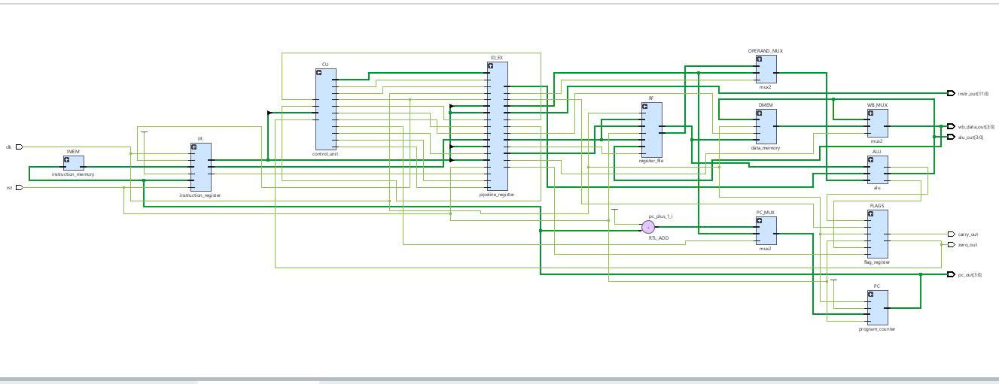
RTL SCHEMATIC OF CPU_TOP (VIVADO)
IMEM
IR
CU
ID_EX
RF
OPERAND_MUX
ALU
FLAGS
DMEM
WB_MUX
PC_MUX
PC
PC+1 ADD
Observation Ports: pc_out[3:0] · instr_out[11:0] · alu_out[3:0] · wb_data_out[3:0] · zero_out · carry_out
Bui Huu Loi · SE196720 · 4-Bit RISC CPU
13

Slide 14
TEST PROGRAMS
program.mem – demo program
prog_jump.mem – jump & flush testing
Addr | Hex | Instruction | Result
0 | 645 | LDI R1, 5 | R1 = 0101
1 | 683 | LDI R2, 3 | R2 = 0011
2 | 060 | ADD R1, R2 | R1 = 1000 (8)
3 | 6CA | LDI R3, 10 | R3 = 1010
4 | 470 | XOR R1, R3 | R1 = 0010 (2)
5 | A05 | JMP 5 | Infinite loop
Addr | Hex | Instruction | Effect
0 | 601 | LDI R0, 1 | R0 = 1; PC 0 → 1
1 | A04 | JMP 4 | PC = 4; flush addr 2–3
2–3 | 60F | LDI R0, 15 | never executes
4–5 | 647, 150 | LDI R1,7; SUB R1,R1 | R1 = 0, Zero = 1
6 | B09 | JZ 9 | taken: PC = 9; flush 7–8
9–10 | 6C2, 0F0 | LDI R3,2; ADD R3,R3 | R3 = 0100, Zero = 0
11 | B0E | JZ 14 | not taken: continue
12–13 | 686, A0D | LDI R2,6; JMP 13 | R2 = 0110; halt
Others: prog_arith.mem (ADD, SUB, STORE, LOAD, Zero) and prog_logic.mem (AND, OR, XOR, MOV, NOT, LDI). Empty words = C00 (NOP).
Bui Huu Loi · SE196720 · 4-Bit RISC CPU
14

Slide 15
SELF-CHECKING TESTBENCH (TB_CPU.V)
How It Works
# | Program | Check | Value | Res
1 | program.mem | ADD R1, R2 (5+3) | 1000 | PASS
2 | program.mem | XOR R1, R3 | 0010 | PASS
3 | prog_arith.mem | ADD R1, R2 → R1 | 1000 | PASS
4 | prog_arith.mem | STORE R1, 0 → DMEM[0] | 1000 | PASS
5 | prog_arith.mem | SUB R1, R2 → R1 | 0010 | PASS
6 | prog_logic.mem | AND → R3 | 1000 | PASS
7 | prog_jump.mem | JMP 4: PC = 0100 | 0100 | PASS
• Loads each .mem program into instruction memory, resets CPU
• Waits until the target instruction is in EX, compares with expected value, prints PASS/FAIL
• Tasks: load_program, reset_cpu (holds reset for 2 clocks), finish(addr), check
• Waits per instruction since cycle count varies after jumps
7 / 7 checks PASS, errors = 0
Bui Huu Loi · SE196720 · 4-Bit RISC CPU
15

Slide 16
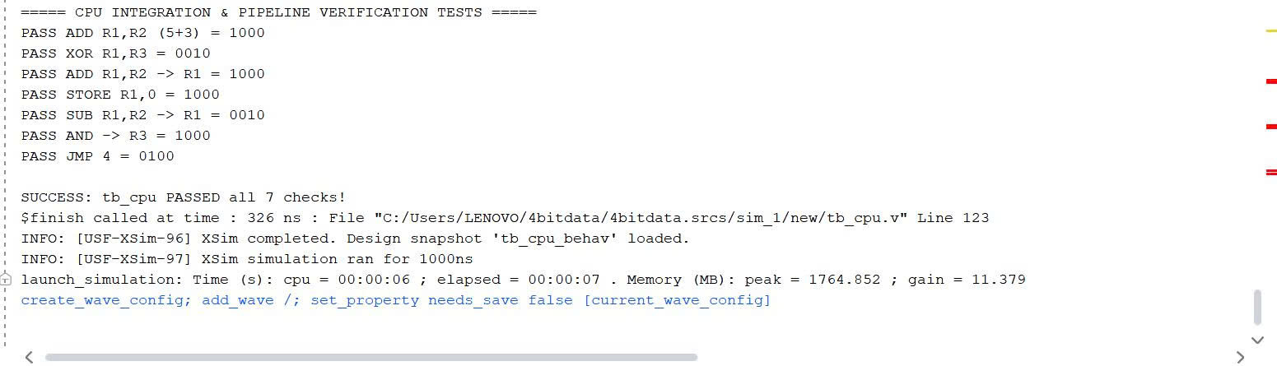
SIMULATION RESULTS – TCL CONSOLE
7 / 7
errors = 0
326 ns
all checks PASS
no errors found
$finish at tb_cpu.v
Bui Huu Loi · SE196720 · 4-Bit RISC CPU
16

Slide 17
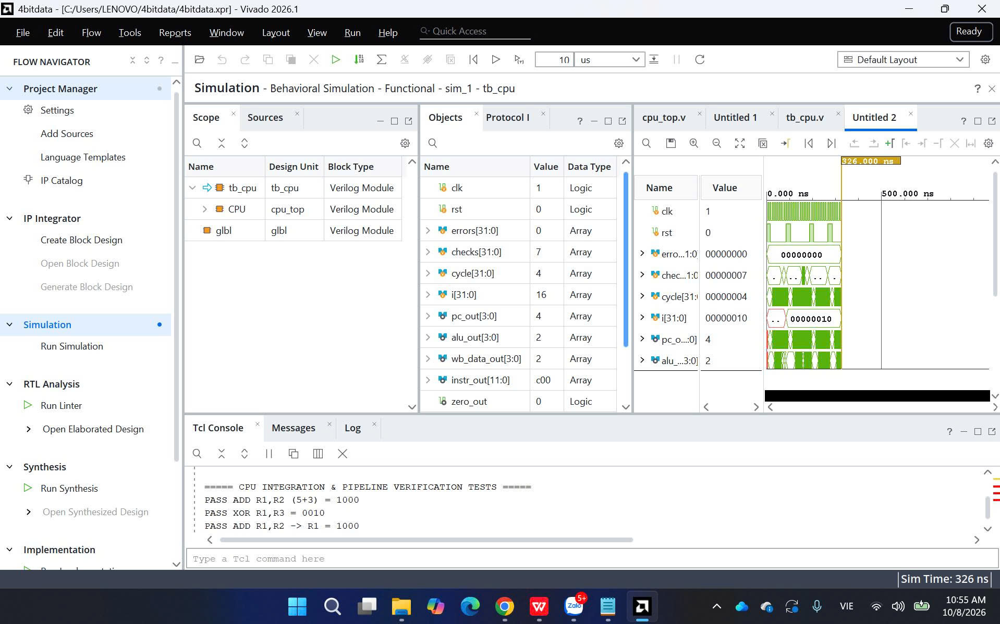
FULL SIMULATION WAVEFORM (0 – 326 NS)
Observations
► rst is pulsed before each test program
► checks increment up to 7
► errors remain at 0
► pc_out and alu_out follow the running program
Bui Huu Loi · SE196720 · 4-Bit RISC CPU
17

Slide 18
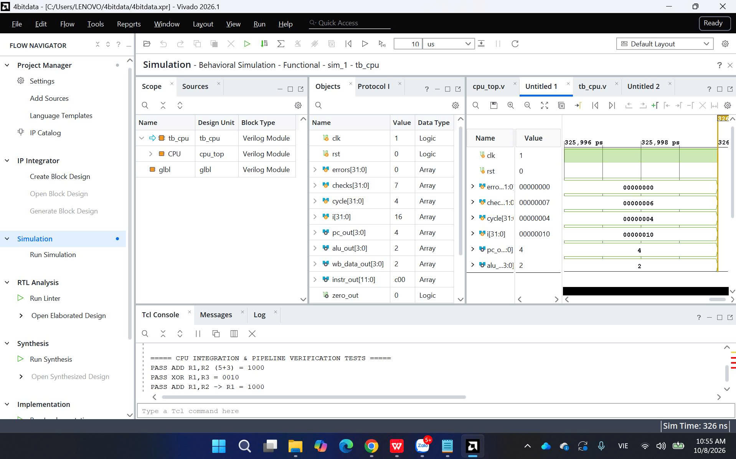
SIGNAL VALUES AT 326 NS
Final Results
► errors = 0, checks = 7
► pc_out = 4 (correct for JMP 4)
► instr_out = c00 (NOP in EX)
► zero_out = 0, both flags are 0
► Sim Time: 326 ns
Bui Huu Loi · SE196720 · 4-Bit RISC CPU
18

Slide 19
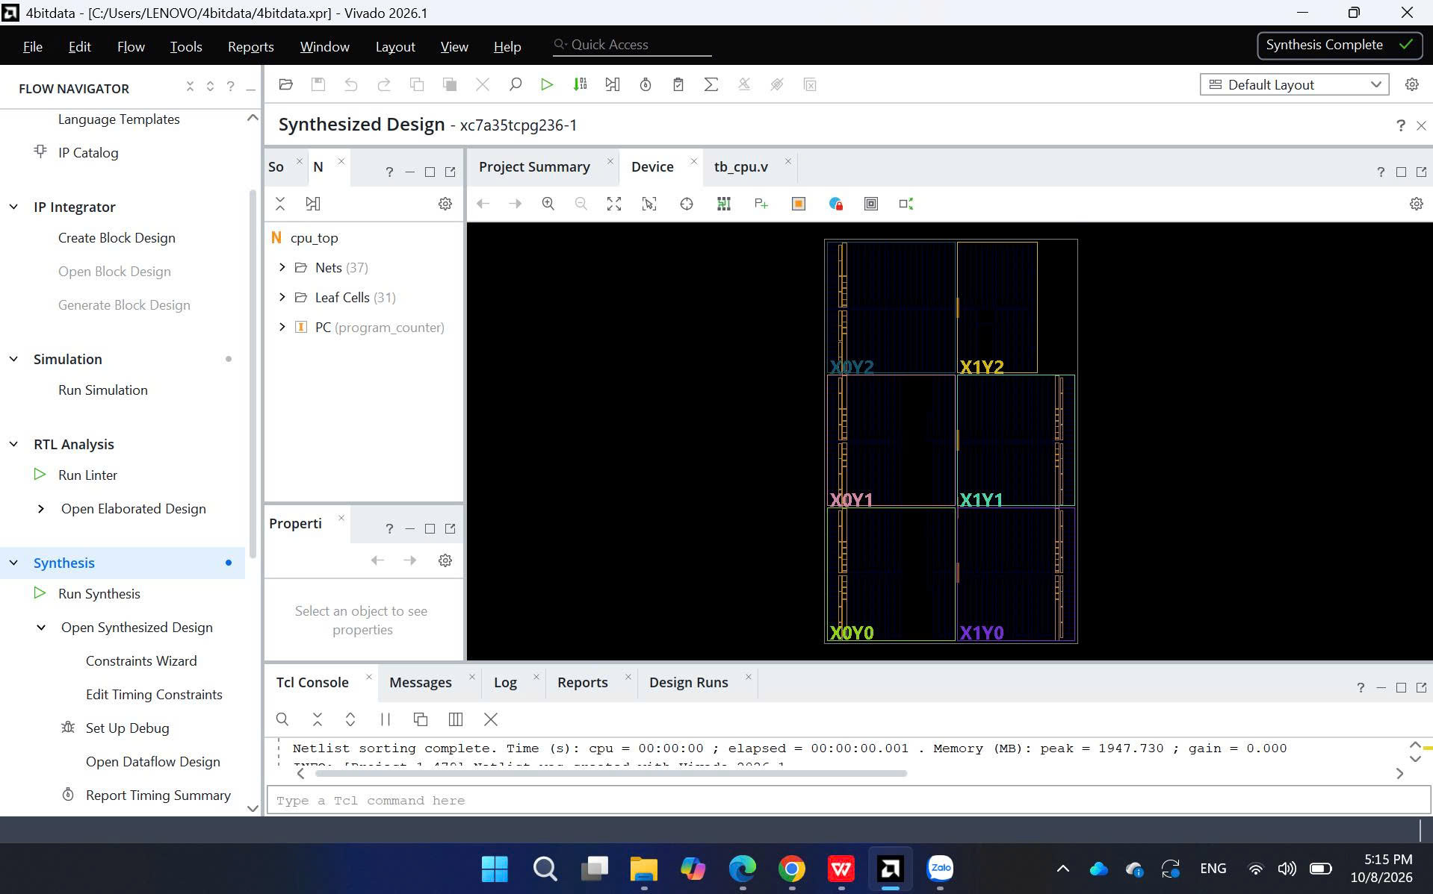
SYNTHESIS ON ARTIX-7
Synthesis Complete
Vivado 2026.1
37 nets · 31 cells
Leaf cells at cpu_top level
xc7a35tcpg236-1
Target device Artix-7
Includes hierarchical cells like PC.
Bui Huu Loi · SE196720 · 4-Bit RISC CPU
19

Slide 20
TIMING & CONSTRAINTS
Check Timing: 17 Warnings
# constraints.xdc (e.g., 100 MHz)
create_clock -period 10.000 -name clk [get_ports clk]
set_input_delay -clock clk 2.000 [get_ports rst]
set_output_delay -clock clk 2.000 \
[get_ports {pc_out[*] instr_out[*] \
alu_out[*] wb_data_out[*] \
zero_out carry_out}]
► All due to missing constraints
► 8 unconstrained internal endpoints
► 4 no clock · 4 no output delay · 1 no input delay
► Consequence: Without clock constraints, WNS and Fmax are meaningless; max frequency is not reported
► Next Step: Add .xdc file, rerun implementation, check utilization report
Bui Huu Loi · SE196720 · 4-Bit RISC CPU
20

Slide 21
PERFORMANCE
Program | Inst | Clock | CPI | 2 clk/inst | Speedup
Demo (up to XOR) | 5 | 7 | 1.40 | 10 | 1.4x
Arithmetic & Mem | 9 | 11 | 1.22 | 18 | 1.6x
Logic | 12 | 14 | 1.17 | 24 | 1.7x
Jump (2 taken) | 10 | 16 | 1.60 | 20 | 1.25x
Long, no jump | N | N + 2 | → 1 | 2N | → 2x
N + 2 + 2J
Formula: N non-jump instructions require N + 2 clocks; each taken jump adds 2
Bui Huu Loi · SE196720 · 4-Bit RISC CPU
21

Slide 22
LIMITATIONS & FUTURE WORK
Jump Cost
Size Limits
Taken jumps cost 2 clocks because they are decided in EX.
→ Resolve JMP in ID or use branch prediction.
Max 16 instructions and 16 data words.
→ Expand bit fields, relative jumps, indirect LOAD/STORE via registers.
Instruction Set
Timing
Only one conditional jump; lacks overflow/negative flags, CALL/RET.
→ Use reserved opcodes for JC, JNZ, shifts, HALT.
No constraints defined.
→ Add XDC, measure max frequency and resource utilization.
Bui Huu Loi · SE196720 · 4-Bit RISC CPU
22

Slide 23
CONCLUSION
► Successfully designed, implemented, and verified a 4-bit RISC CPU using Verilog HDL
► Datapath: 4-bit ALU, 2-port register file, PC, IMEM 16×12, DMEM 16×4, 3 MUXes; hardwired control
► 3-stage pipeline IF/ID/EX: 1 instruction completes per clock when the pipeline is full
► Data hazards avoided by reading registers in EX; control hazards handled by flushing 2 instructions after a taken jump
► Testbench: 7 checks PASS, 0 errors in 326 ns; successful synthesis on xc7a35tcpg236-1
12
3
7 / 7
326 ns
Instructions
Pipeline stages
Checks PASS
Sim time
Bui Huu Loi · SE196720 · 4-Bit RISC CPU
23

Slide 24
Thank You
Bui Huu Loi
ID: SE196720
Any Questions?
FPT University | IC Design

